Slide 1


Prepared for Jigsaw
May 2022
Final Presentation Gen Z Info Lit Study

Slide 2
Table of Contents
1 | Mission | 3
2 | Methodology | 4
3 | Framework Shift: From “Literacy” to “Sensibility” | 6
4 | How Gen Z Practices Information Sensibility | 12
5 | Judging Credibility | 21
6 | Problems Gen Z Encounters | 24
7 | Mapping Info Sensibility Journeys | 30
8 | Information Personas | 33
9 | Building with Info Sensibility | 38
10 | Design Principles | 45

Slide 3
MISSION
To understand how Gen Z makes sense of online information in order to help reduce their receptivity to misinformation.

Slide 4
2 | METHODOLOGY
We conducted a 5-stage ethnographic research design.
1
2
3
4
5
DESK RESEARCH
DYAD INTERVIEWS
DIARY STUDY
1:1 INTERVIEWS
ANALYSIS & CONCEPTING
250+ sources consulted
5 expert interviews
70+ hours of interviews
100+ text & video entries
18+ hours of concept testing
150+ insights stress-tested

Slide 5

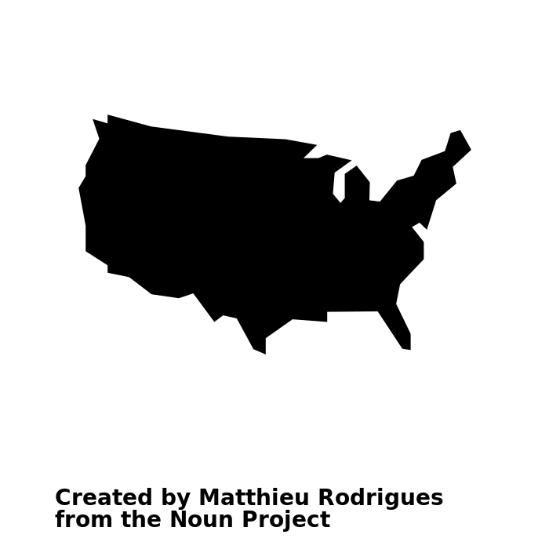


2 | METHODOLOGY
We recruited 35 Gen Z internet users from a wide range of backgrounds & political orientations.
SAMPLE OVERVIEW
Age
Geography
Education
Politics
18 | 13 - 17 years old
17 | 18 - 24 years old
7 | Midwest
7 | Northeast
10 | West
11 | South
16 | Some high school
4 | Four-year BA degree
1 | High school degree
4 | Two-year Associate degree
9 | Some college
1 | N/A
2 | “Very conservative”
4 | “Conservative”
14 | “Moderate”
10 | “Liberal”
5 | “Very liberal”
“Mainstream”
“Alternative / Fringe”
We split our sample into 2 major user segments based on app usage

Slide 6
3 | FRAMEWORK SHIFT
TYPES of CONCERNS
What are the core competencies for evaluating valid online information?
Can Gen Zers recognize logical fallacies & biases?
But we discovered that info literacy fails to capture how Gen Zers actually make sense of information in their everyday lives.
We started with the framework of information literacy.
What sources of information do they find credible?
How can we prevent Gen Zers from being deceived?
How can we make Gen Zers better at researching and fact-checking?

Slide 7
3 | FRAMEWORK SHIFT
TYPES of CONCERNS
We repeatedly heard
Gen Z express more socially-oriented concerns.
What would my parents think about this issue?
Do I feel a personal connection with this source or influencer?
For Gen Z, info-seeking is motivated by more than simply the desire to know what is “true.”
Is this information based on firsthand experience?
What do people like me think about this information?
Why are so many people sharing this information?

Slide 8
We believe these findings are pointing to a new paradigm:
information sensibility.

Slide 9
Gen Z relies on it while using online information to navigate their social environments.
Information sensibility is a socially informed awareness of the value of online information, relying on folk heuristics of credibility.
The relevance of different kinds of information to their personal lives (e.g. goals, relationships).
A set of informal criteria for evaluating credibility that are contextually applied.

Slide 10
3 | FRAMEWORK SHIFT
Shifting our focus from information literacy to sensibility helps to frame the Gen Z experience of information consumption in different terms:
info researchers
info practitioners
cognitive skills deficit
abundance of social inputs
rational ability
relational ability

Slide 11
3 | FRAMEWORK SHIFT
Gen Zers use information to pursue two key goals:
Making sure I belong
(normativity)
Making sure I’m sure
(certainty)
Is this thinking acceptable?
What kind of person values this?
Who else thinks this way?
Are those people like me?
Does this feel right?
Do I know enough to talk about this (in a way that sounds smart)?
What if it turns out to be wrong?
How can I know enough to be comfortable?

Slide 12

KEY QUESTION
How do Gen Zers practice information sensibility?
04 |
How Gen Z practices information sensibility
KEY INSIGHT
Gen Zers interpret information together as aspirational members of social groups, not in isolation as individuals.
Notes:
As it is socially oriented, the work involved in applying information sensibility is often ad hoc and highly variable.
But we did identify a general set of informational practices Gen Zers use when asking themselves “Does this make sense to me?” or “Does this feel right?”

Slide 13
4 | PRACTICES
Crowdsourcing credibility
WHAT DOES IT MEAN?
HOW DOES IT WORK?
Gen Zers crowdsource their thinking by observing how other users react to the same information they are consuming.
Whether reading the comments or tallying likes on a post, Gen Zers rely on the judgment of their peers and their sense of “the discourse” to socially orient themselves and decide what to believe.
They like to take the social temperature of how users in general are responding to a piece of content.

Slide 14
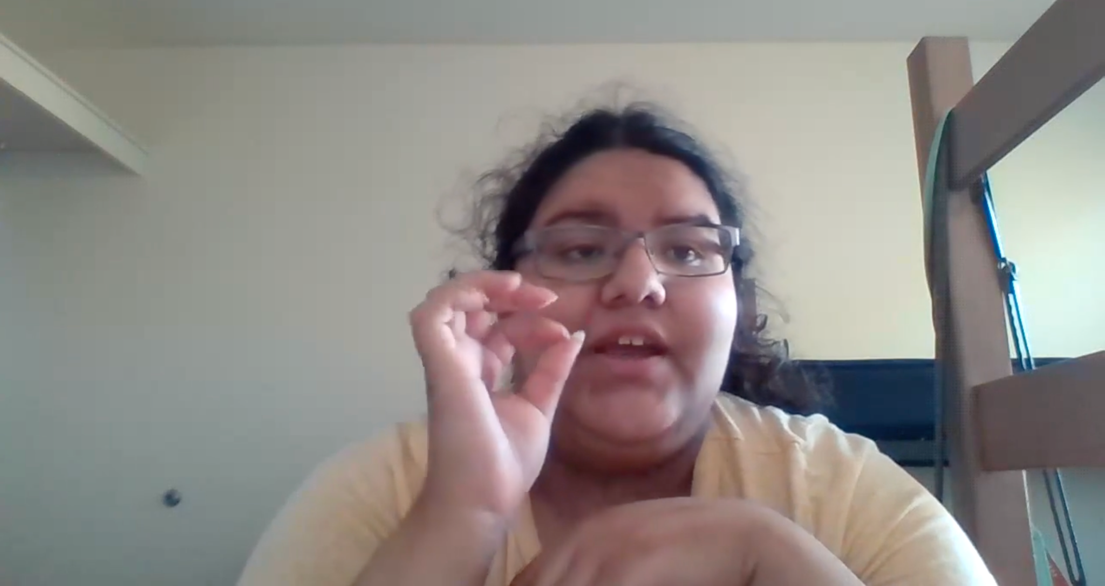

Crowdsourcing credibility in action
Most of the time I use the comments to see what other people are saying, if they’re confirming it or denying it or correcting it. I try to double check my sources with the comments, by googling, and with other content creators and what they say.
– Delly (18-24 / Mainstream)

Slide 15
4 | PRACTICES
Surrogate thinking
WHAT DOES IT MEAN?
HOW DOES IT WORK?
Go-to public personalities and influencers act as surrogate thinkers to help Gen Zers interpret information.
Gen Zers select influencers with similar values to filter information and clarify points of view – effectively doing the ‘thinking’ for them, because users trust that others have done the work.
Public personalities also serve as role models: Gen Zers want to learn how others apply logic or build arguments – and how to know when you’ve done enough thinking to be confident in the conclusions you come to.

Slide 16
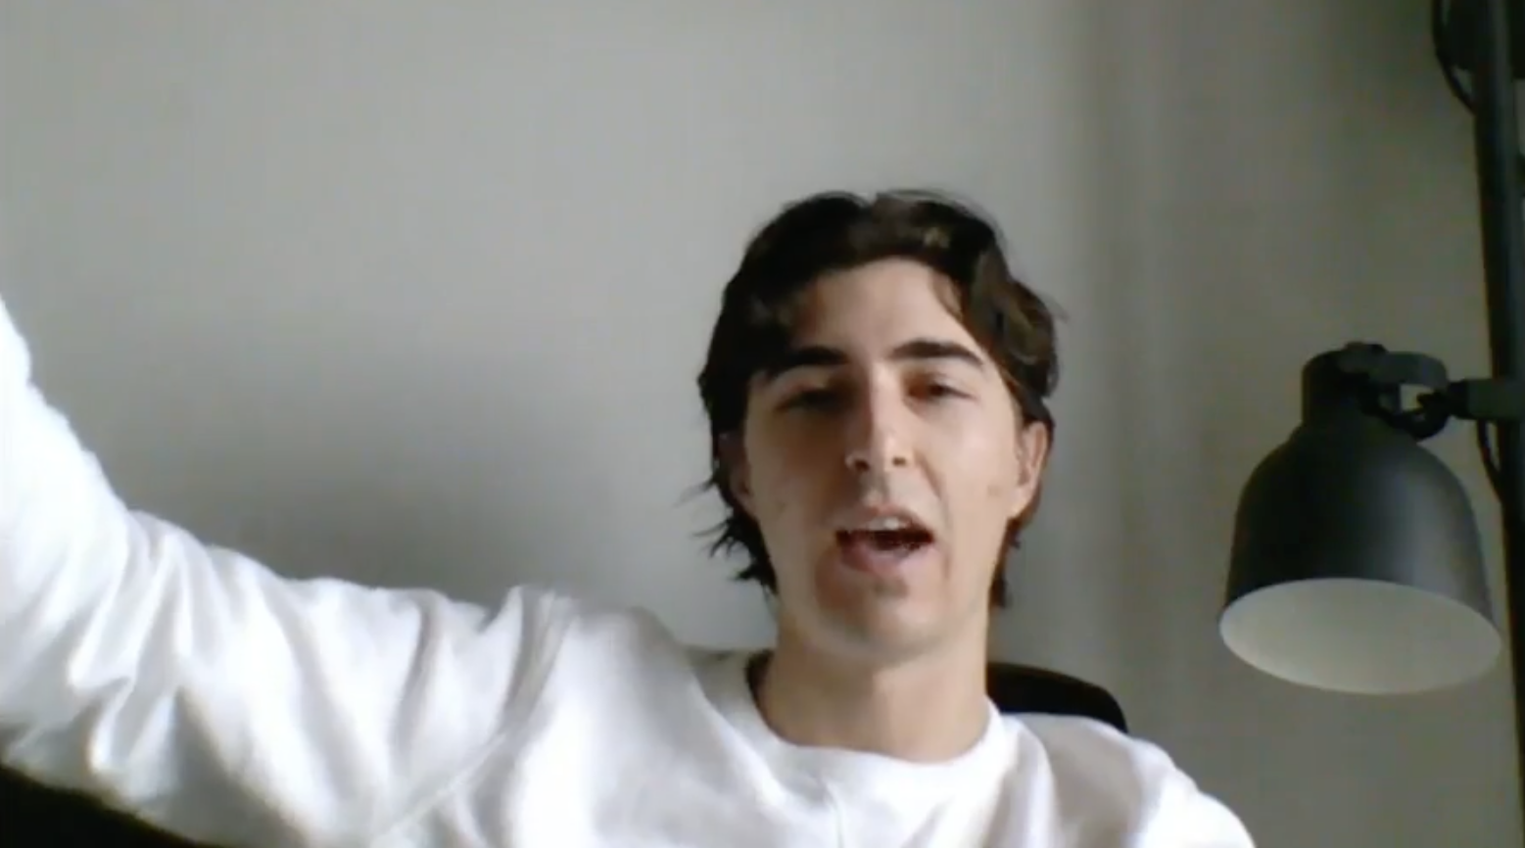
Surrogate thinking in action
Q. Have you ever fact-checked Jordan Peterson?
You know, I generally take him at his word… I know he’s intelligent & well-read, but I guess now I’d be more inclined to fact-check. In the past I’ve just taken him at his word, because I know he’s very well-read.
– Jack (18-24 / Alternative)

Slide 17

4 | PRACTICES
Orbital thinking
WHAT DOES IT MEAN?
HOW DOES IT WORK?
Gen Z’s thinking is affected by orbiting forces: family influences, social ties, personal experiences, and trusted online sources. They interpret new information based on their orientation toward these various forces.
Gen Z users use orbital thinking to orient their evaluations with family, peers, and go-to sources.
Orbital thinking suggests potential for reorientation. A user’s gravitational center can shift as new values exert more pull. The most dramatic shifts are likely to result from social connections, whether online or off.

Slide 18
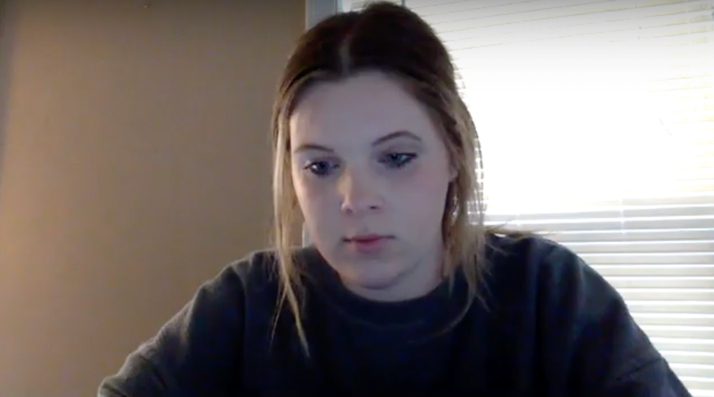
Orbital thinking in action
Before my sister and I moved out of the house, we were more Republican leaning. When I went to college, I learned a lot of different things. My family had this idea that it was going to turn me into a liberal.
– Alex (18-24 / Mainstream)

Slide 19

CASE STUDY // Newsmax
Many participants emphasized that the news consumed by older family members shapes their own sense of what is credible online.
Whether watching Newsmax with grandparents or listening to NPR before going to school, Gen Zers’ experiences with traditional news media at home shape how they judge information online.
In time, Gen Zers may travel away from these early family influences, if they encounter a strong enough pull by another value-system or person.
Notes:
Hit all of the practices – orbital thinking, surrogate thinking, crowdsourcing.

Slide 20
4 | PRACTICES
Implications
Help make it a shared experience
Embed interventions
Google can help Gen Z users better connect with others while searching and evaluating information.
Google can ensure that interventions appear as a natural part of the info practice they target, not a disruptive imposition.
From the Field
From the Field
Did Katy Perry kill a nun?
“People also ask”
Notes:
Max and Skye (13-17, Mainstream) were among the only participants in our study who trust Wikipedia. The conversation is always ongoing, they told us. When investigating the rumor that Katy Perry killed a nun, they were disappointed to find no info on Wikipedia. If Katy Perry fans didn’t weigh in, Max and Skye concluded, the story must not be true.
While searching does water get dusty during a screenshare exercise, Carly and Sarah (13-17, Mainstream) told us they love Google’s “People also ask” feature. Sometimes the wording is better, sometimes the questions are “super smart.” But Carly and Sarah also appreciated that this feature resembles the crowdsourcing they already do online.

Slide 21
KEY QUESTION
How do Gen Zers determine whether online information is credible?
05 |
Judging credibility
KEY INSIGHT
Though the rules of info literacy are never far from mind – check your sources! – Gen Zers also use more informal heuristics to gauge credibility.

Slide 22
5 | JUDGING CREDIBILITY
The folk heuristics of information sensibility are a loosely related set of criteria with which users evaluate information credibility.
HEURISTIC CRITERIA
Convenience // The degree to which the information is easy to access and share online.
Searching on Google is a hassle, it’s more for school. TikTok is more fun. The videos are more interesting and relatable…On TikTok I don’t have to read mounds of paragraphs.
– Bridget (13-17 / Alternative)
Aesthetic // The degree to which the online content “feels right” to them.
Tone // The degree to which information is affectively charged or not – especially negatively.

Slide 23
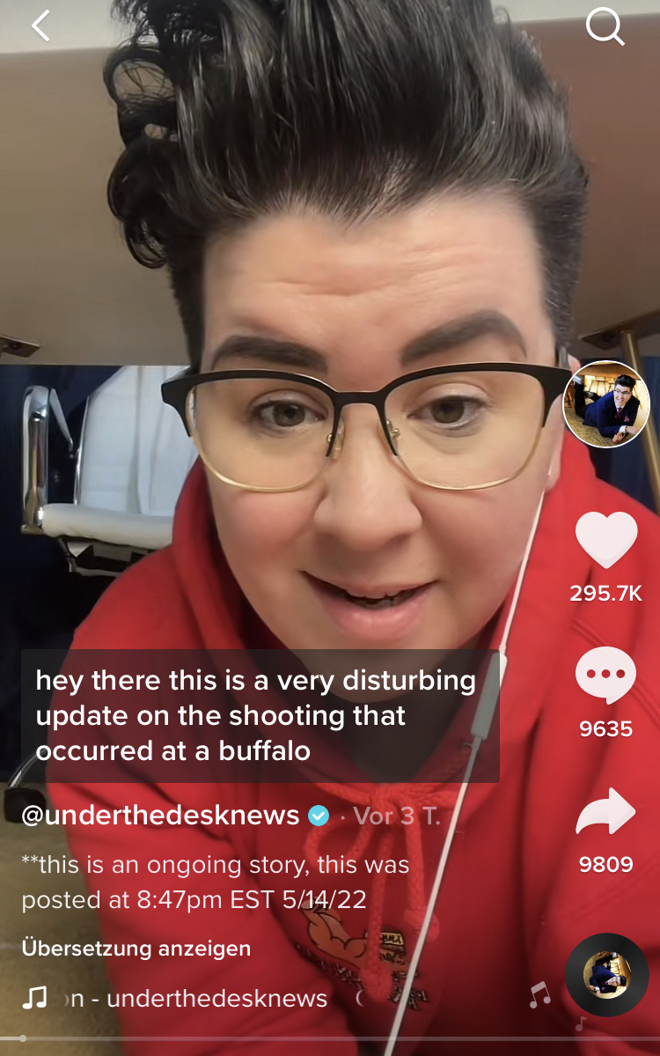
CASE STUDY // Under the Desk News
That several participants liked @underthedesknews on TikTok showcases all three heuristics at play:
Convenience // quick and snappy overviews
Aesthetic // young, informal, queer-presenting individuals in place of the usual talking heads
Tone // gentle and reassuring, making the upsetting news easier to handle
Notes:
This TikTok account meets all three heuristics: tone (neutral, welcoming, gentle); aesthetic (young queer-presenting person; this is Gen Z’s answer to the “talking heads” of mainstream news broadcasts – the body and its environment matters, the aesthetic channeling a “shelter-in-place” vibe; convenience (swipe through, etc., on TikTok).

Slide 24

KEY QUESTION
What problems do Gen Zers experience when trying to make sense of online information?
06 |
Problems
Gen Z encounters
KEY INSIGHT
Gen Zers prize social belonging over seeking the “truth” because they are more interested in crafting their identity than knowing what is true or false.

Slide 25
6 | PROBLEMS GEN Z ENCOUNTERS
We identified three types of problems that Gen Zers experience while practicing information sensibility.
misrecognition
information overload
social error

Slide 26
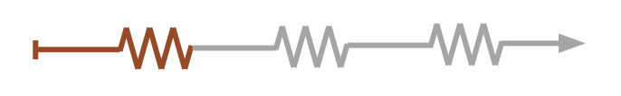
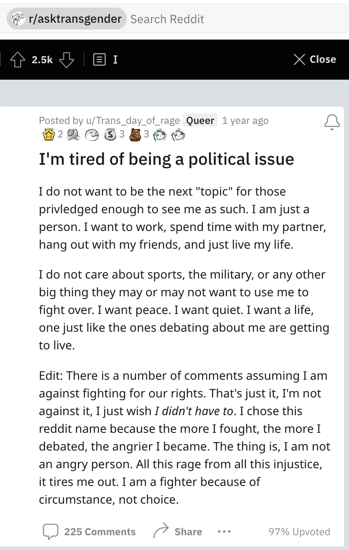
6 | PROBLEMS GEN Z ENCOUNTERS
Deluged by facts, opinions, and ads, Gen Zers try to stay
positive – & in control – in the midst of information overload.
HOW INFO OVERLOAD IS EXPERIENCED
STRATEGIES
Content is too long
Bail early by swiping or clicking away
Too much content with aggressive tone
Manipulate algorithms to get neutral vibes
Too many pop-up ads feel disruptive
Avoid sites that have too many pop-up ads
Subreddits can be safe spaces for trans people, but they can also become emotionally-volatile echo chambers.
Notes:
Sarah (18-24, Alternative), a trans woman from Ohio, described trans subreddits are safe spaces for queer people to discuss the information that matters. But they can easily become emotionally volatile echo chambers where “people start riling each other up.”
That can also be a “dangerous trap to fall into,” Sarah told us, “making it hard to tell what’s true and what isn’t.”

Slide 27


6 | PROBLEMS GEN Z ENCOUNTERS
Gen Zers feel that platforms and apps don’t understand them as a generation, causing them to feel misrecognized.
HOW MISRECOGNITION IS EXPERIENCED
STRATEGIES
The language of mainstream media
Seek sources that “speak their language”
Interventions’ tone and style feel patronizing
Overestimate abilities – “I don’t need this”
Lack of open comments misreads what users like
Opt for news on social media
Max said that “If you’re making an attempt to relate, then you’re fundamentally unrelatable.”
Notes:
According to Max (13-17 / Mainstream), Gen Z knows all of the “invisible rules” of the internet. Even if tech companies did have something to teach his peers, they haven’t found the right way to do so. When disparaging the animated YouTube interventions we shared with him, Max said it all comes down to relatability, though with a twist. “My generation sees this as an attempt to relate - if you’re making an attempt to relate, you’re fundamentally unrelatable.”

Slide 28
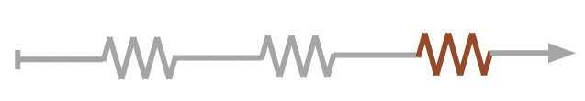
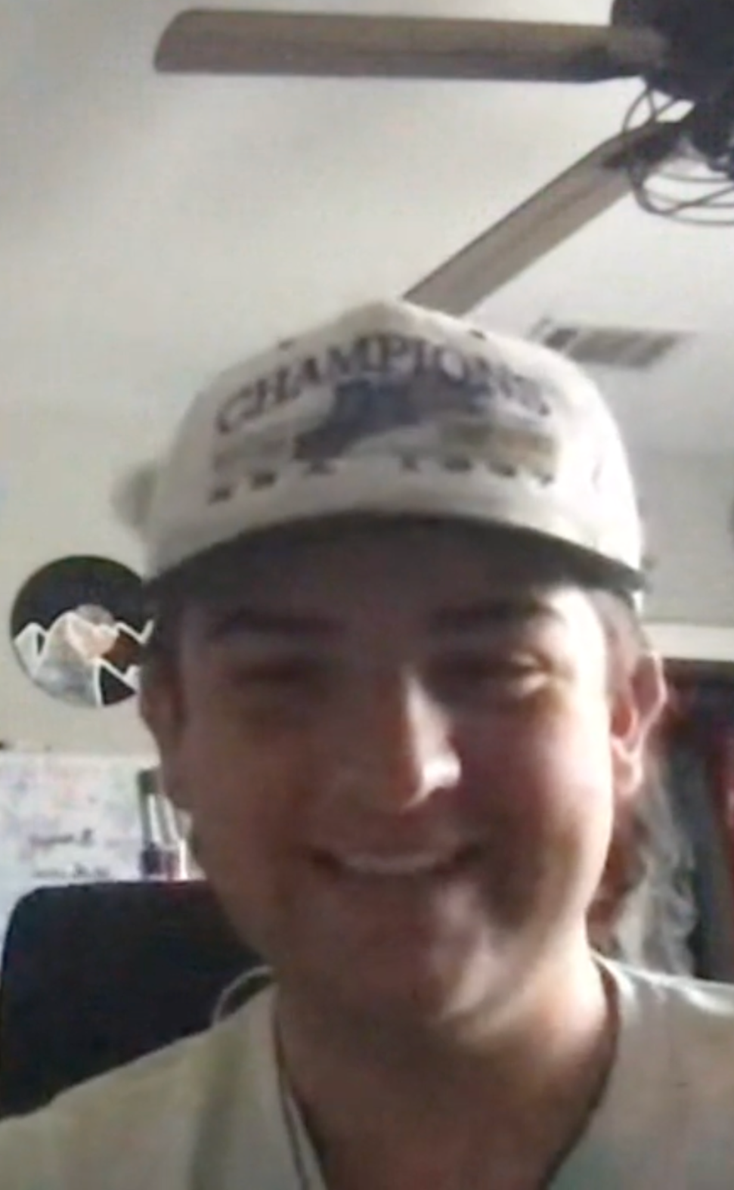
6 | PROBLEMS GEN Z ENCOUNTERS
The social cost of being wrong – social error – can be steep, leading users to be risk-averse
HOW FEAR OF SOCIAL
ERROR IS EXPERIENCED
STRATEGIES
Spending energy to avoid offending others
Avoid controversial topics, seek social safety
Worry about being misinformed
Check comments to orient socially
Threat of being canceled
Hide posts from friends and family
Blake thought he knew what “people online liked,” then he got doxxed.
Notes:
Blake (13-17 / Alternative) posted content to Instagram that he was pretty sure “people online liked.” Soon, however, he discovered that not everyone at his school agreed. After being doxxed and intimidated on the street by people he had never met, Blake transferred schools. Still in his early teens, Blake wants to “get back to the earlier days” when things were simpler.

Slide 29
6 | PROBLEMS GEN Z ENCOUNTERS
Implications
Help users cut through the noise
Target social frictions, not just factual errors
Google could help Gen Zers access core information and insights from content more quickly.
Google could assist Gen Zers with processing information by creating space for them to ask questions without fear of judgment.

Slide 30
KEY QUESTION
What do the information journeys of Gen Zers look like?
07 |
Mapping info sensibility journeys
KEY INSIGHT
Gen Z info journeys are non-linear, since they largely encounter information rather than search for it.

Slide 31


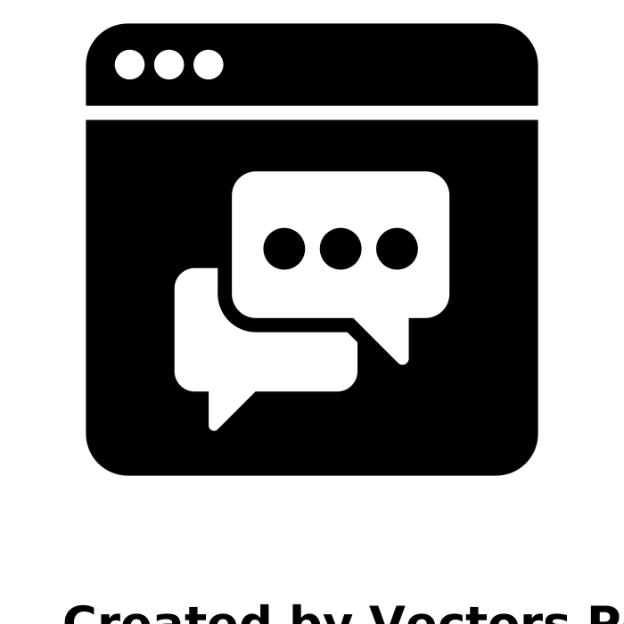
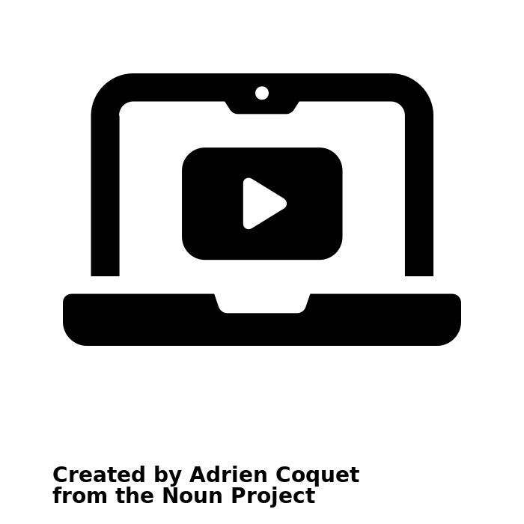


7 | MAPPING INFO SENSIBILITY JOURNEYS
Gen Z information journeys function as interconnected forces that are unevenly weighted, depending on the value of the topic and how they apply their heuristics in relation to it
FROM: Info literacy understanding of information journeys
TO: Info sensibility understanding of information journeys
Experiences
Question
Info / content
Answer
Comment
Sections
Online
Info
– informed
+
informed
Web search
Credibility check
Family
Assumes that users have a goal in reaching the “truth.”
Users gravitate toward what matters most contextually
Notes:
Define each of the icons
No discrete beginning/end – not about being more or less informed, it’s about sensing when you’ve done enough.
Bang around these nodes – you don’t necessarily know where you are in this process, no definitive ending.
Ad hoc

Slide 32
7 | MAPPING INFO SENSIBILITY JOURNEYS
Different users weigh some nodes more heavily than others.
Relies heavily on the comments sections
Relies heavily on conversations with family
Relies heavily on trusted online info or go-to sources
Reading the comments makes me feel that I’m with other people while I’m talking, because these are other people’s opinions.
– Ruby (18-24 / Mainstream)
I’d also ask my parents… whatever they say is the truth.
– Carly (13-17 / Mainstream)
I go to ZeroHedge because they basically have everything I’m looking for. If I go to Google, usually I’ll type ZeroHedge into the search box too.
– Isabel (18-24 / Alternative)
Notes:
Even though all of these nodes are part of the user journey, some of them play more important roles than other.
These are the three that we believe we can speak to confidently – discrete and easily recognizable points of reference (caveat) – this is not exhaustive.
We observed that the magnifying glass (values and curiosities), but didn’t have saturation; it’s part of the journey, but not a clear standout. Great concern from comment spaces, family, go-to sources.
Preempt the questions: these three played an outsized role.

Slide 33

KEY QUESTION
What increases Gen Z's susceptibility to misinformation?
08 |
Information personas
KEY INSIGHT
Gen Z's susceptibility to misinformation is linked to lower tolerance for uncertainty and high demand for upholding views that are normative in their communities.

Slide 34
8 | INFORMATION PERSONAS
We propose a dynamic model for Gen Z susceptibility to misinformation:
TWO AXES
We observed two distinct concerns around online information:
Degree of certainty: how much the user cares about the level of clarity it provides them about a valued topic.
Degree of normativity: how much the user cares about whether or not the information is publicly acceptable.
THREE PERSONAS
These two axes rendered three qualitatively distinct personas:
Gumby: It’s complicated, & I’m okay with that
Disciple: It’s complicated, but I have to know what’s right
Contrarian: I don’t want to to be a sheeple
Notes:
Some people who value more certainty, some people who value normativity
Degrees

Slide 35

8 | INFORMATION PERSONAS
Gumby
It’s complicated, & I’m okay with that
Disciple
It’s complicated, but I have to know what’s right
Contrarian
I don’t want to to be a sheeple
H
H
H
Tolerance for uncertainty
Tolerance for uncertainty
Tolerance for uncertainty
L
H
L
H
L
H
Preference for normativity
Preference for normativity
Preference for normativity
They’re okay with a lot of uncertainty.
They’re flexible about whether the information is publicly acceptable or not – as long as they feel it is accurate.
Generally less susceptible to misinformation because they’re okay with open-endedness.
They’re not okay with a lot of uncertainty
They care about the information being publicly acceptable.
Dependent on misinformation when it is socially normative.
They’re not interested in nuance, and want to feel high level of certainty
They prefer the information to be oppositional.
Dependent on misinformation for explicitly contrarian politics.
Notes:
Go with the flow - ‘it’s complicated, and I’m ok with that’
Pick your battles - ‘it’s complicated, but I know what I believe / but the truth isn’t / but not really / right and wrong isn’t complicated / ground truths /
What’s right isn’t complicated / right and wrong shouldn’t be complicated / it’s easy to know what right / The truth is complicated, but I know what’s right
Circle the wagons - ‘I don’t want to be sheeple’
Go with the flow has higher range
Pick your battles – uncomfortable with ambiguity,
Upper left hand quadrant – could exist, but we didn’t bump into it.

Slide 36
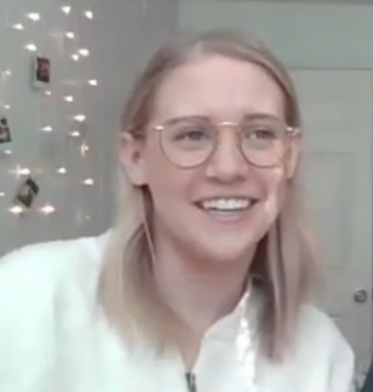
8 | INFORMATION PERSONAS
Ethnographic Spotlight – Kai
18-24 / “Mainstream”
She identifies as a “middle of the road” Republican, listens to NPR, and “believes in science.” But her commitment to natural immunity causes her to mistrust the peer-reviewed scientific literature on Covid vaccines. She remained unvaccinated at the time of our interview. She’s a disciple because she searches for information that supports her worldview.
WHAT DOES SHE TEACH US?
WHY DOES IT MATTER?
Reliance on misinformation is not limited to “Alternative” participants; “Mainstream” Gen Zers can take extreme positions on topics they feel strongly about.
It doesn’t matter if something is true or false. What matters is whether the information before Kai matches up with her beliefs–and she will always be able to reject content that doesn’t and find content that does.
Rather than getting users to make a hard switch, we should work on making pivots gradually.
Notes:
Speakers notes: point out this experience was not exceptional in our data set.

Slide 37
8 | INFORMATION PERSONAS
Implications
Mainstreaming through misinformation
Embed interventions
Google should avoid conflating the objective evaluation of info quality (“misinformation”) with its social evaluation (“alternative”).
Info sensibility personas are dynamic. We can use several interventions to pivot a person from one persona to another.
From the Field
From the Field
The truth doesn’t change, does it?
“I feel like, naturally
I would believe him.”
Notes:
Cub (18-24) said the CDC had lost all credibility for him. It wasn’t that he distrusted science. He was just confused when the CDC revised its mask recommendations. Cub’s gut told him the truth doesn’t change.
Anne (13-17) and her religious family believe misinformation on covid and BLM. Anne is also a fan of Justin Bieber because of his faith. She likes it most when Bieber talks religion, but she would also trust what he said about covid – which might mean rethinking the attitudes she inherited from her family. “I feel like I would believe him, just because I’ve been believing in what he says is true – I feel like naturally I would still believe him”

Slide 38
Avoid overload
Diversify information choices
Normalize uncertainty
Rebrand information literacy
Increase transparency
09 |
Building with information sensibility

Slide 39
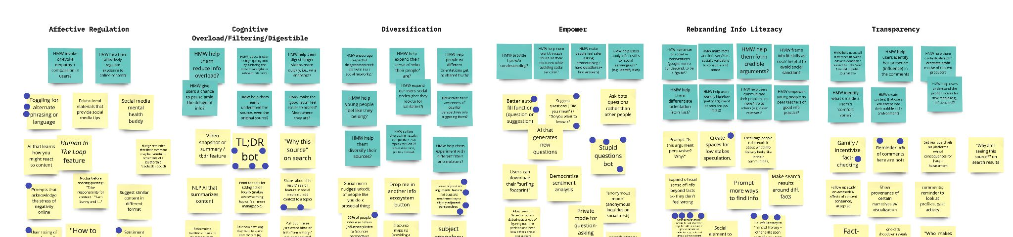
9 | BUILDING WITH INFO SENSIBILITY
Five distinct problem + opportunity spaces emerged through our analysis:
Diversify information choices
Rebrand info literacy
Avoid overload
Normalize uncertainty
Increase transparency

Slide 40
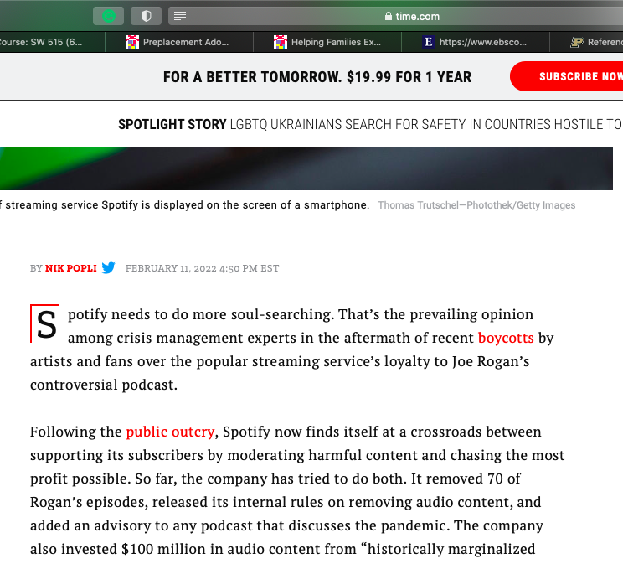
9 | BUILDING WITH INFO SENSIBILITY
Avoid overload
Gen Zers want to better regulate the emotional impact and cognitive load that they experience while interacting with online information.
Solution suggestions
App / browser-level features that offer the CliffsNotes or interject positive content when the flow of content feels constantly negative.
“It was too long to read so I didn’t even read all of it” - Alex (18-24 / Mainstream)
😖
😖
😖
😖
😌
Positive interjections
App feature that can auto-detect doom scrolling and redirect users by interjecting positive content into a stream of negative content
TL;DR bot
An app that gives the short version
Notes:
This unlocks crowdsourcing, because it obstructs ability to meaningfully engage with comments.

Slide 41
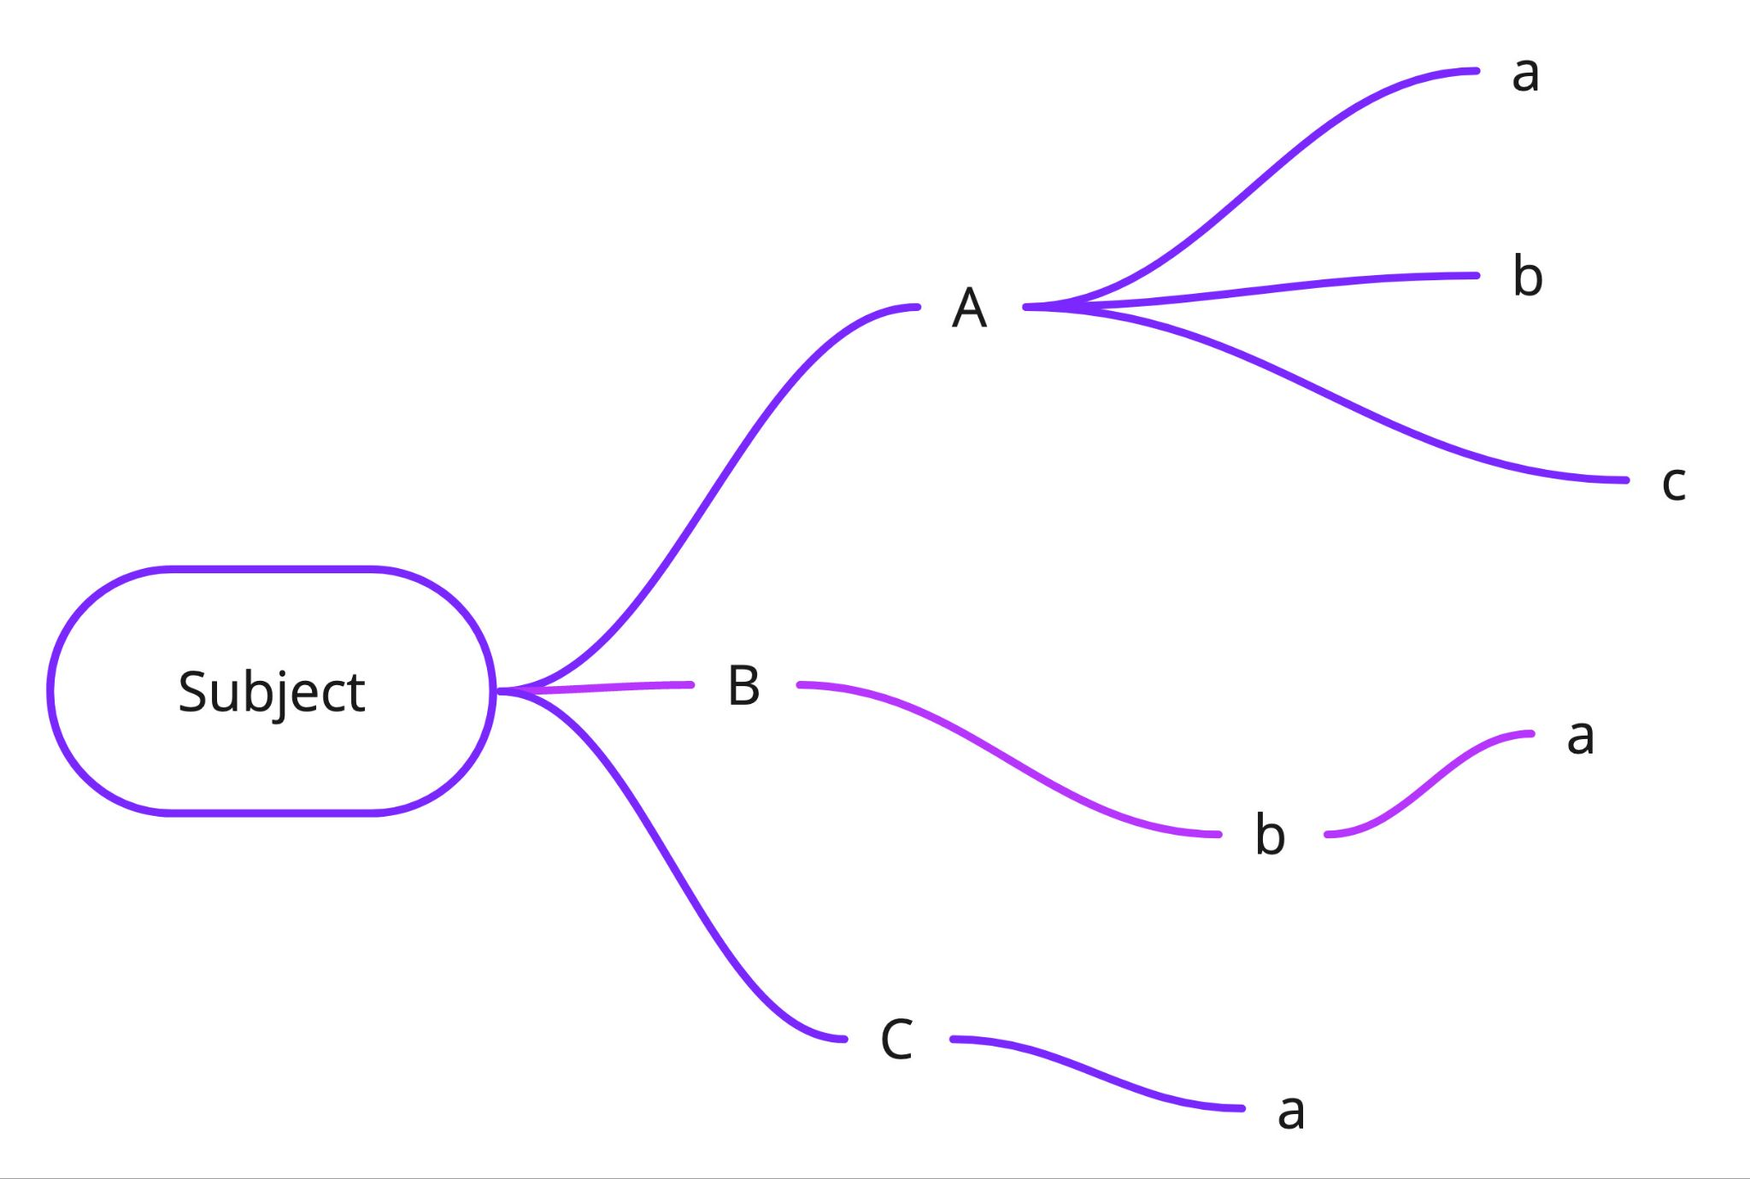
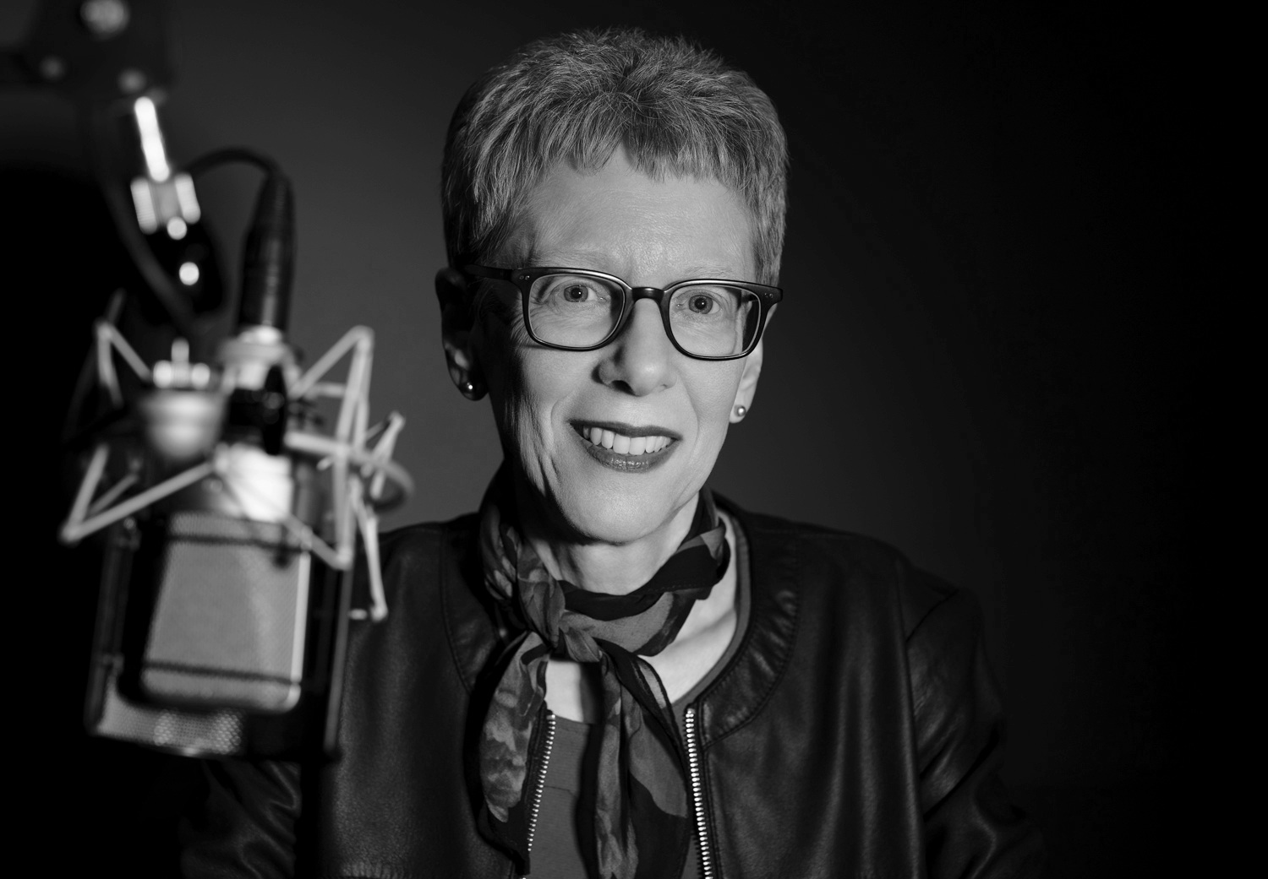
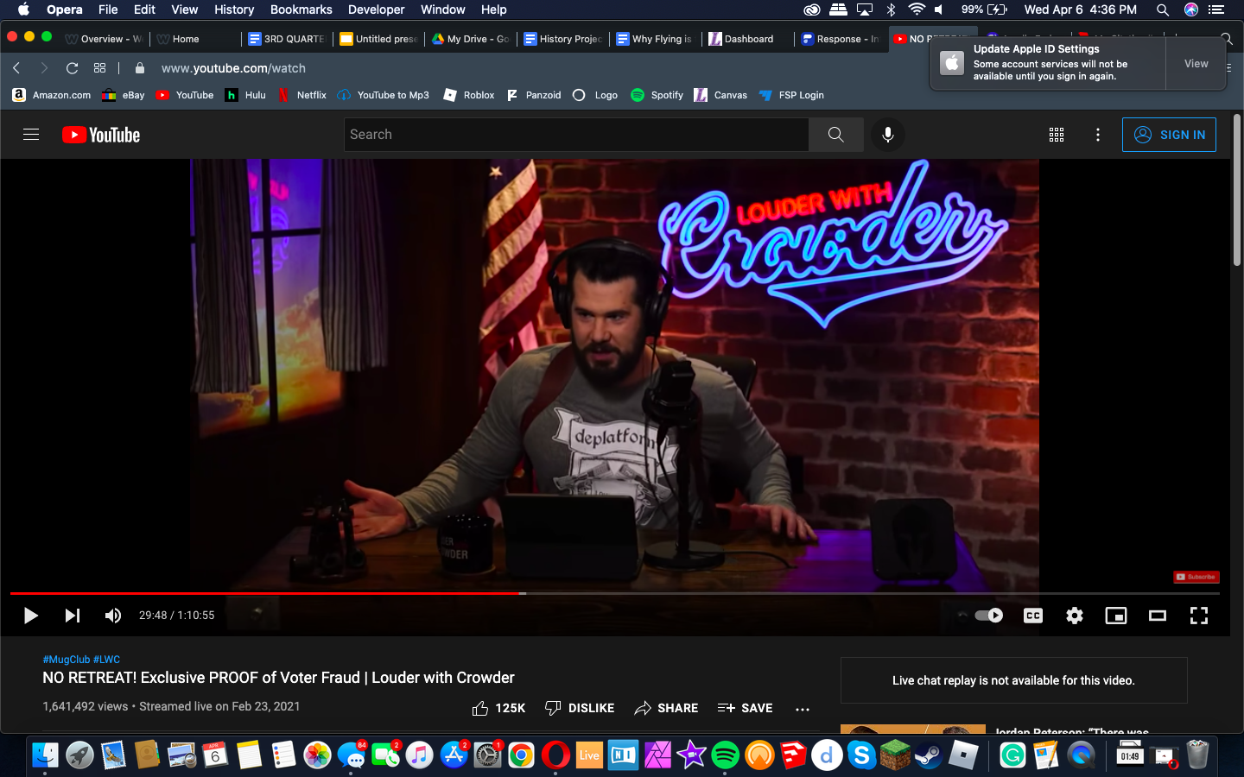
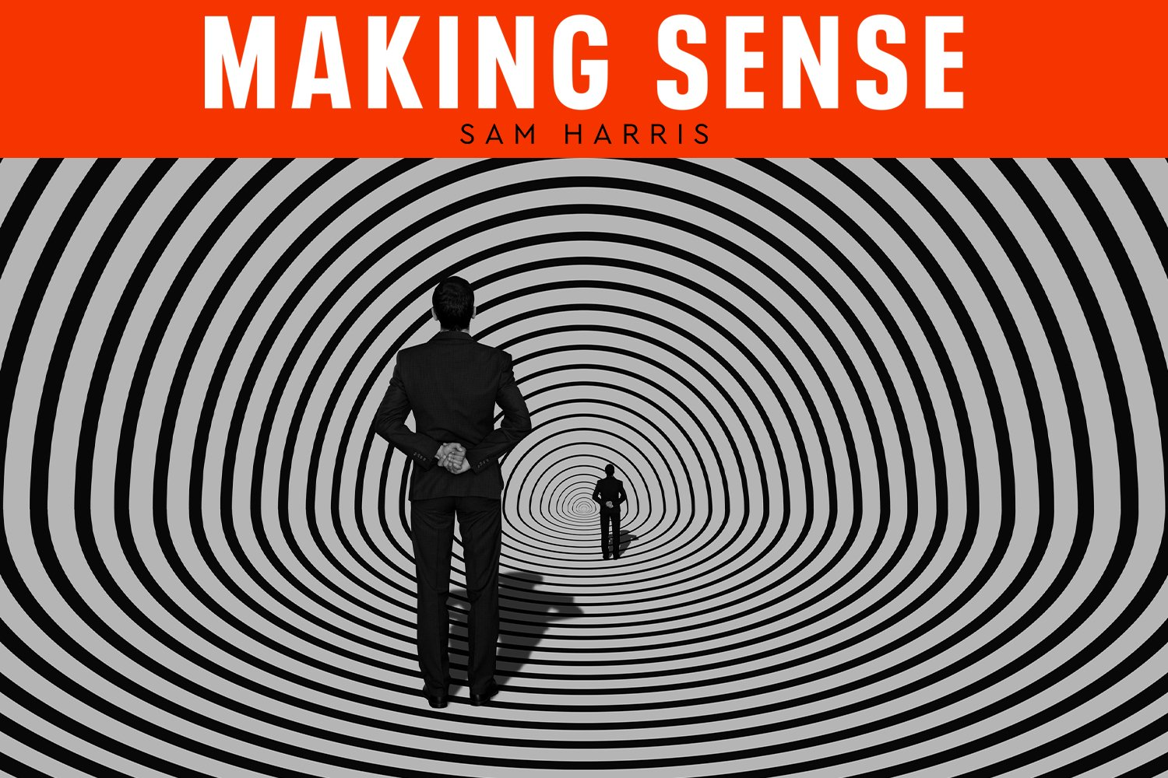
9 | BUILDING WITH INFO SENSIBILITY
Diversify information choices
Gen Zers want to select from a wider range of quality information that is accessible and convenient.
Solution suggestions
The idea of exposing users to adjacent perspectives rather than simply counter-perspectives.
X - Not polar opposite (e.g. Terri Gross) served up
✓Adjacent (e.g. Sam Harris) – Show “adjacent perspectives” for search results
Search pathways to an help guide users along a readymade journey with quality sources.
Notes:
relate each one to either practice or pain point.

Slide 42
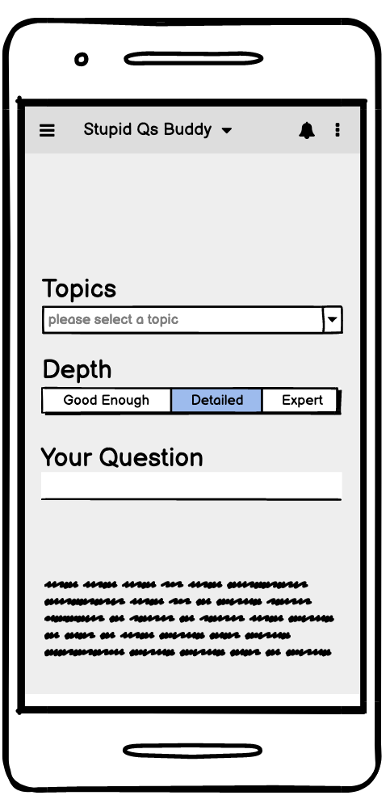
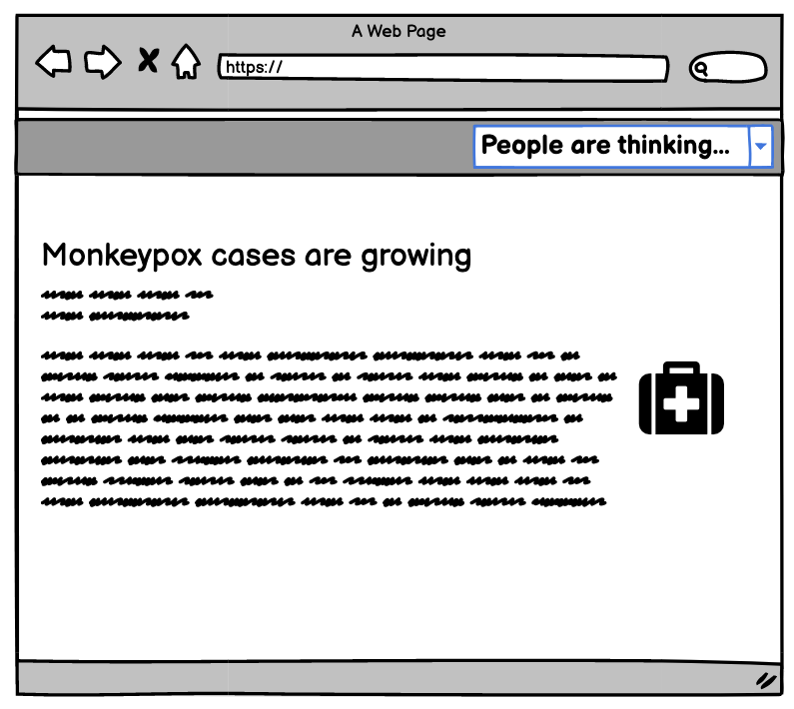
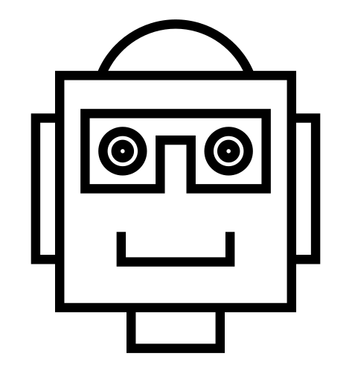
9 | BUILDING WITH INFO SENSIBILITY
Normalize uncertainty
Gen Zers want to navigate their information ecosystems more confidently and without worrying about failing to find the answers.
Solution suggestions
Help users feel at ease with not knowing, rather than seeing it as ignorance or an intellectual failure.
Stupid Question bot
An information assistant that allows Gen Z users to ask a bot rather than post on a forum because they find it embarrassing or uncomfortable.
Social thermometer
This prompt (Search or YouTube) would validate Gen Z crowdsourcing strategies, and bolster their sense that getting “a feel for the debate” can be as useful as deciding what’s “true.”
Notes:
relate each one to either practice or painpoint.

Slide 43
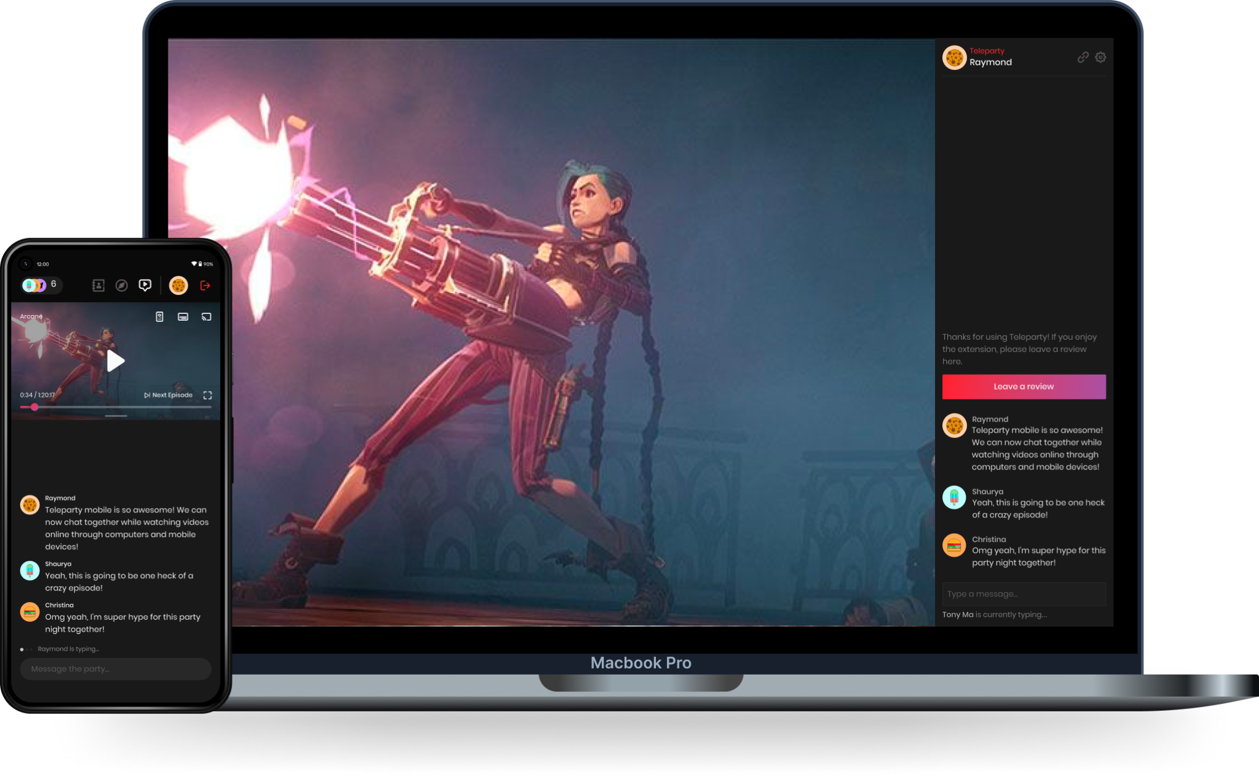
9 | BUILDING WITH INFO SENSIBILITY
Rebrand information literacy
Gen Zers feel that info literacy is an academic skill that fails to equip them to handle today’s information ecosystem and less relevant to their everyday lives.
Solution suggestions
Browser extensions that allow users to collaborate casually and socially when searching for information.
Popular platforms like Twitch and Teleparty allow users to share online activities like gaming or watching movies using a basic chat + screenshare interface.
Search Together: A Chrome extension to screenshare live searching with close friends or core communities.
Text chat (like Twitch) or audio chat (like Discord) to help brainstorm while evaluating information.
Notes:
relate each one to either practice or painpoint.

Slide 44
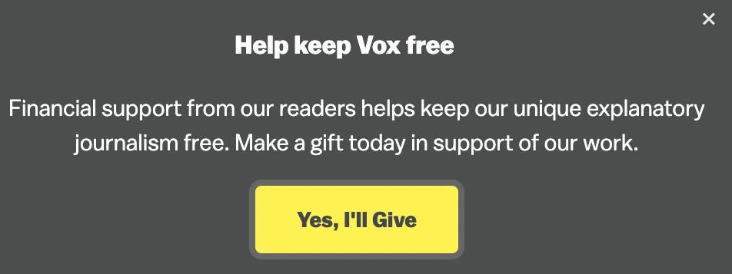
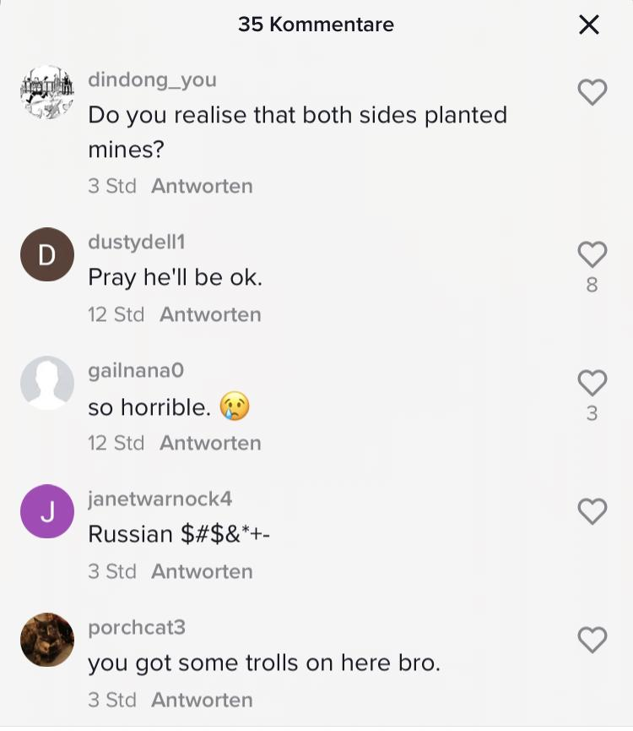
9 | BUILDING WITH INFO SENSIBILITY
Increase transparency
Gen Zers want to understand the logic of the platforms and monetized content they interact with.
Solution suggestions
Helping users differentiate between monetized content vs. non-monetized content to understand the funding sources and financial incentives behind content. Also, reminding users that bots leave comments.
Ext. that explains: This is how Vox makes $ and why they are asking for $
Reminder: “Some of the comments here may be from bots.”
Red Flag: This kind of message alarmed users because any mention of money made is suspect. Profit = Biased
Chrome extension that identifies paid content or informs users about monetization models.
Notes:
relate each one to either practice or painpoint.

Slide 45
Avoid black-boxing
Make uncertainty comfortable
Enable ecological thinking
Make the content more accessible
10 |
Design principles

Slide 46
10 | DESIGN PRINCIPLES
Avoid black-boxing
Make uncertainty comfortable
Enable ecological thinking
Make content
more accessible
Make explicit origins of content (e.g. funding) and how they function (e.g. trigger logic).
Help users accept “not knowing” as an legitimate outcome of their information journey.
Help users recognize how their engagement with online content affects others.
Aim to help users more easily access and understand quality online information.
Users trust interventions when they feel in control.
Users are drawn to misinformation because it promises clarity.
Misinformation has knock- on effects that are not easy to anticipate.
Users settle for misinformation when they cannot find quality info.
Gumby
Disciple
Contrarian
Gumby
Disciple
Contrarian
Gumby
Disciple
Contrarian
Gumby
Disciple
Contrarian
Notes:
Interventions should help users recognize how their engagement with online content affects others, rather than reinforcing the idea that info literacy is a personal choice.

Slide 47
Thank you

